Slide 1

Welcome
Project on
Supply Chain Analysis

Slide 2
candidate information :
Name :Abhijeet Nivas Shinde
Email : shindeabhijeet540@gmail.Com
Name :om Kishor Chavan
Email : omc53297@gmail.Com
Project : CDACL-003-Supply Chain Analysis

Slide 3
Project Overview :
The project aims to analyze the supply chain performance of a company using the available dataset. The dataset includes details such as product types, pricing, sales, supplier information, manufacturing costs, lead times, and shipping details.
Using this data, a complete diagnostic report and dashboard were created to identify:
Key supply chain performance metrics
Comparison between different products
Patterns and trends in sales, cost, and lead times
Areas for improving efficiency and reducing cost
The analysis and dashboard are prepared using power BI to visualize and interpret the company’s supply chain performance effectively.

Slide 4
ABOUT THE DATASET :
The dataset used for this project contains key information related to the company’s supply chain operations. It includes multiple parameters covering product, sales, supplier, manufacturing, and logistics aspects.
Key attributes in the dataset:
Product type and SKU (unique identification)
Price, availability, and sales quantity
Revenue generated and stock levels
Supplier details and location
Manufacturing lead time and cost
Shipping time, cost, and carrier information
Inspection results and defect rates
Transportation modes, routes, and costs
The dataset provided a comprehensive view of the supply chain process — from manufacturing to customer delivery — allowing effective analysis and visualization.

Slide 5
Project Index
Sales & Revenue Analysis 1 .Revenue by product type 2.Average volume sold by product type 3.Average product price by type 4.Revenue contribution by demographics 5.Order quantity – revenue correlation
Inventory Management 6. Product availability by type 7. Stock level vs. Availability correlation
Supplier Performance 8. Supplier volume by product type 9.Average supplier defect rate 10. Lead time by supplier location 11. Inspection failure rate by supplier
Production & Manufacturing 12. Total production volume by type 13.Average manufacturing time & cost by type 14. Defect rate – cost correlation by supplier
SHIPPING & LOGISTICS 15. average shipping costs by carrier 16. primary transport mode by product type 17. average shipping time by carrier & mode 18. highest cost shipping routes
QUALITY ASSURANCE 19. inspection results distribution by type
LEAD TIME PERFORMANCE 20.longest average lead time by type

Slide 6
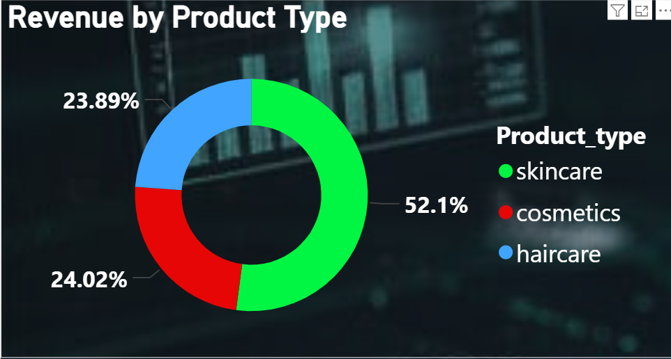
Revenue by product type
Insight:
revenue by product type skincare contributes 52.1% - it's the top revenue generator. Cosmetics make up 24.02% of total revenue. Haircare accounts for 23.89%, the lowest among the three.
Solutions
Focus more on skincare - increase marketing and maintain stock since it's performing best. Boost cosmetics & haircare sales - introduce discounts, bundles, or ads to increase revenue share. Analyze pricing and demand trends - check if skincare's high revenue is from high prices or high volume.

Slide 7
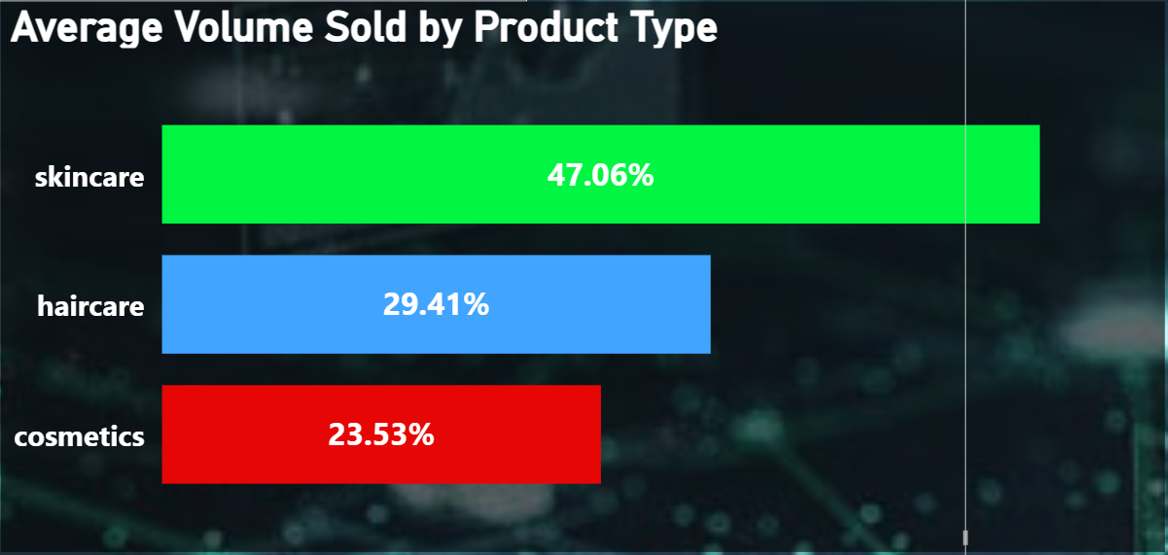
Average Volume Sold by Product Type
Insights
Skincare products have the highest average sales volume (47.06%), showing strong customer demand.
Haircare contributes moderately (29.41%) to total sales.
Cosmetics have the lowest sales (23.53%), indicating lower market preference or limited reach.
Solutions
Focus on skincare category — increase stock and marketing efforts to maintain growth.
Promote cosmetics with discounts or campaigns to boost visibility and sales.
Optimize supply chain for haircare to improve efficiency and possibly increase sales share.

Slide 8
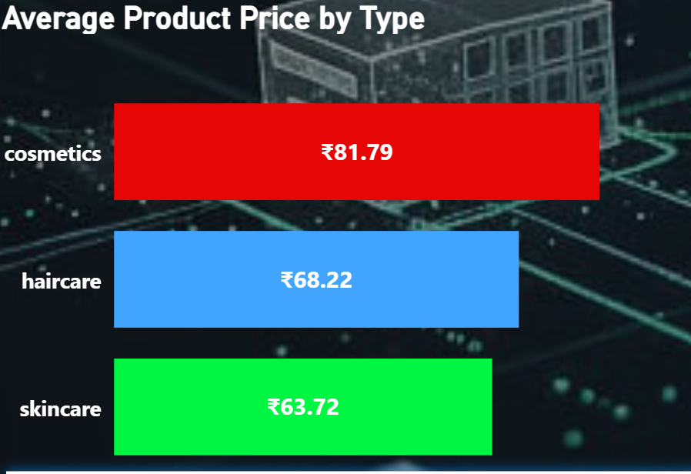
Average Product Price by Type
Insights
Cosmetics (₹81.79): this category has the highest average price, indicating a premium market position or higher-value ingredients/brands.
Skincare (₹63.72): this category has the lowest average price, suggesting it is more price-sensitive or highly competitive.
Haircare (₹68.22): the price is in the middle, offering a balanced price point.
Solutions :
For skincare (price boost): introduce a new line of premium skincare products priced over ₹70 to increase the overall average price and profit margin for the category.
Cross-category strategy: use bundle offers that pair a high-priced cosmetics item with a lower-priced skincare item to drive higher average transaction values across the board.

Slide 9
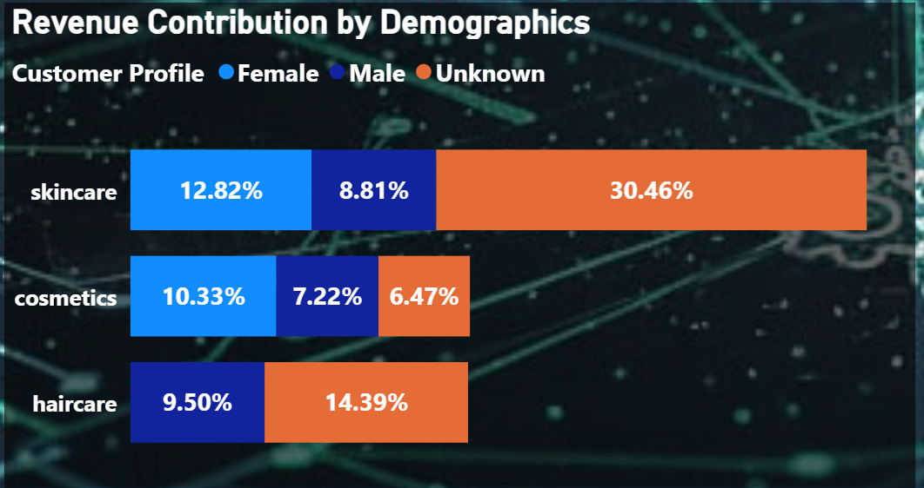
Revenue Contribution by Demographics
Insights : massive data gap: most revenue comes from the 'unknown' category (30.46% in skincare), preventing smart targeting.
Women lead known sales: females are the key identified customers for skincare and cosmetics.
Men are in haircare: males show the strongest preference for haircare.
Solutions :
Mandatory id: immediately implement mandatory sign-up/loyalty to identify the 'unknown' revenue.
Focused marketing: increase spend on campaigns targeting female skincare and male haircare.

Slide 10
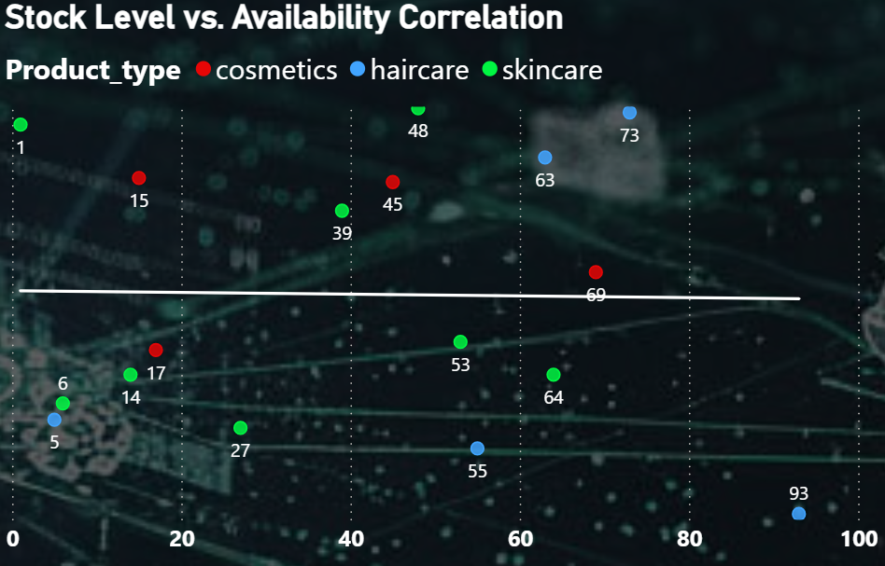
Order Quantity–Revenue Correlation
Insights : skincare (green) shows the most unpredictable stock management, with points spread widely across low and high values.
Haircare (blue) generally demonstrates high availability, with most items clustered toward the right/top side of the chart.
Cosmetics (red) data is too scattered, and the overall picture is unclear without proper x and y axis labels.
Solutions :
Label the axes immediately (x=stock %, y=availability %) to make the plot useful for decision-making.
Investigate skincare outliers (e.g., Points '1' and '6') to fix any critical under-stocking issues or identify low-demand items.

Slide 11
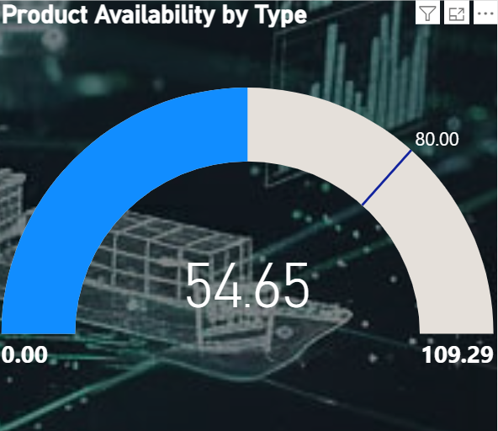
Stock Level vs. Availability Correlation
Insights :
The current average product availability is 54.65 the target availability goal is set at 80.00 current performance is 25.35 points below target, indicating a significant problem with stockouts
Solutions :
Urgently increase stock levels to cover the 25.35-point shortfall review the supply chain to fix bottlenecks and speed up fulfillment processes prioritize inventory for high-volume products to maximize sales recovery

Slide 12
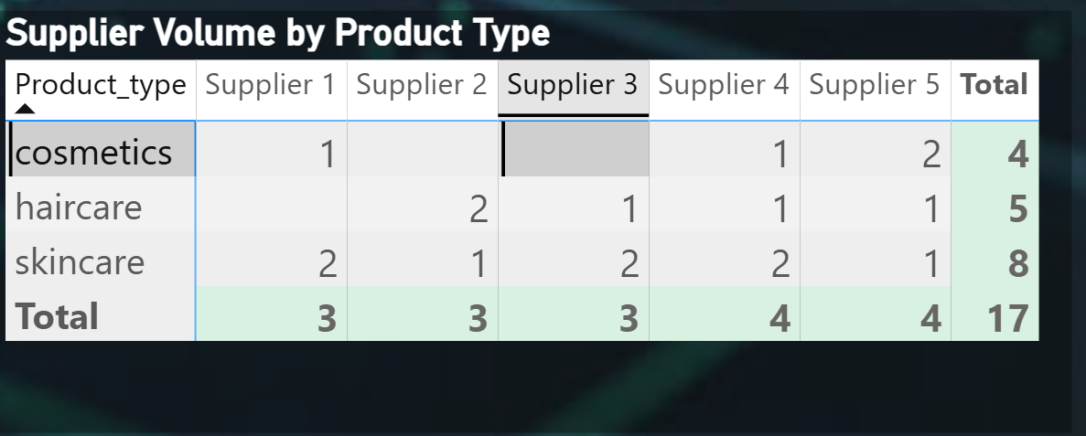
Supplier Volume by Product Type
Insights :
Skincare uses the largest supply base with 8 total volumes, indicating high supplier dependency and potential complexity.
Cosmetics uses the smallest supply base with only 4 total volumes, suggesting high reliance on a few key partners.
Supplier 3 is currently a missed opportunity as they are not supplying the Cosmetics category but are used elsewhere.
Solutions :
Review the 8 Skincare suppliers to consolidate and rationalize the base for improved bulk pricing and supply chain
Immediately engage Supplier 3 for Cosmetics to diversify the supply base and mitigate risk in that category.
Actively expand the overall supplier pool for Cosmetics to reduce reliance on the current limited number of 4 providers.

Slide 13
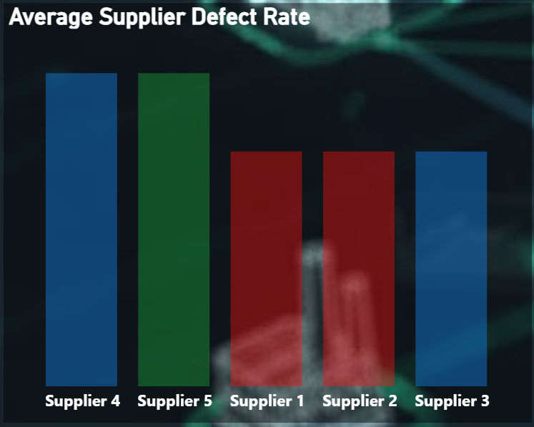
Average Supplier Defect Rate
Insights :
Suppliers 4 and 5 have the highest (worst) average defect rates, as their bars are noticeably taller than the others.
Suppliers 1, 2, and 3 have a lower and more consistent average defect rate, suggesting better quality control.
The difference in defect rates between the highest (4 & 5) and lowest (1, 2, & 3) is visually significant, indicating major quality disparities among the supply base.
Solutions :
Prioritize Audits: Immediately conduct a detailed quality audit of Suppliers 4 and 5 to identify and fix the root causes of their high defect rates.
Shift Volume: Consider reducing or pausing volume to Suppliers 4 and 5, and temporarily shift that volume to the lower-defect Suppliers 1, 2, and 3.

Slide 14
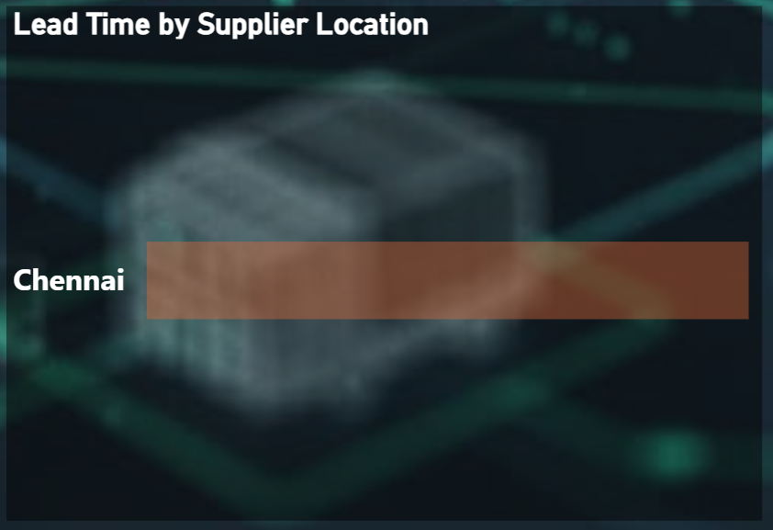
Lead Time by Supplier Location
Insights :
The chart currently displays lead time data only for suppliers located in Chennai.
No numerical value (e.g., days, weeks) is provided to quantify the actual lead time for Chennai.
Without other location data, it's impossible to compare Chennai's lead time to other supplier locations to determine if it's high or low.
Solutions :
Add Comparative Data: Immediately include lead time data for at least one other major supplier location to provide a benchmark for Chennai.
Add Numerical Value: Include the actual lead time number (e.g., 15 days) on the bar for Chennai to make the data actionable.

Slide 15
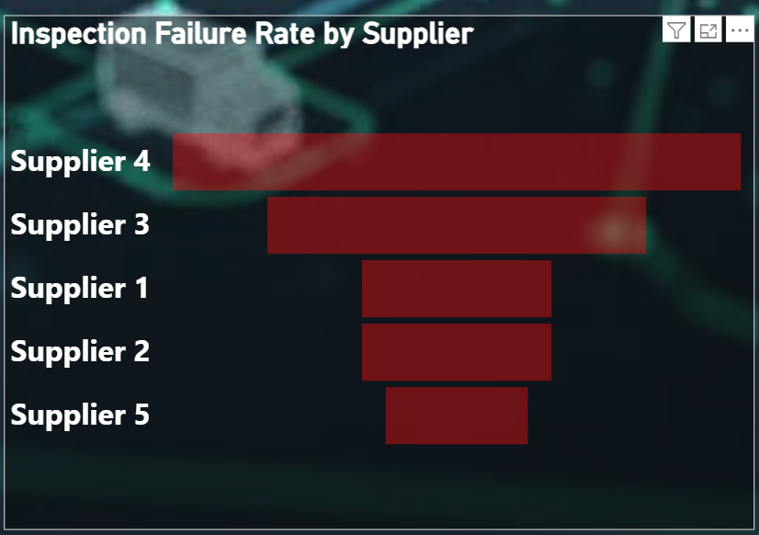
Inspection Failure Rate by Supplier
Insights :
Supplier 4 has the highest (worst) inspection failure rate by a significant margin, posing the biggest quality risk.
Supplier 3 has the second-highest failure rate, making them the next biggest quality concern after Supplier 4.
Suppliers 1, 2, and 5 all have similar, and the lowest, failure rates, indicating they are the most reliable suppliers in terms of quality.
Solutions :
Immediate Action on Supplier 4: Suspend or drastically reduce volume to Supplier 4 until their failure rate is brought down to acceptable levels.
Pressure Supplier 3: Put Supplier 3 on notice and demand a detailed plan to reduce their failure rate to match the performance of Suppliers 1, 2, and 5.

Slide 16
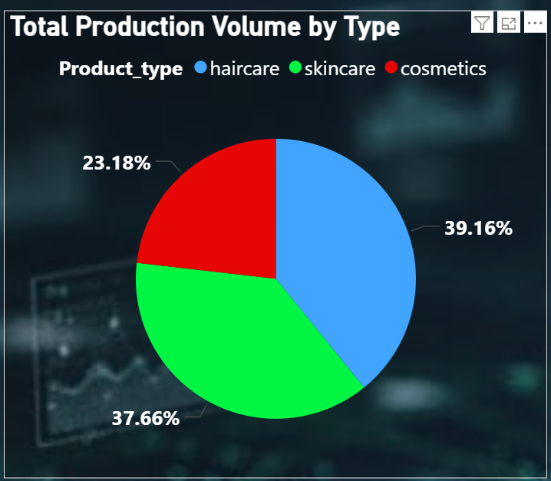
Total Production Volume by Type
Insights :
Haircare has the highest production volume at 39.16%, indicating it's the primary product being manufactured.
Skincare follows very closely as the second-highest volume at 37.66%, showing near-equal production priority with haircare.
Cosmetics have the lowest production volume at 23.18%, suggesting they are a secondary focus in the manufacturing process.
Solutions :
Maintain Haircare/Skincare Balance: Ensure manufacturing capacity is robust enough to efficiently handle the nearly 80% combined volume of Haircare and Skincare to avoid production bottlenecks.
Review Cosmetics Demand: Investigate if the low Cosmetics production volume (23.18%) is due to low demand or a strategic production limitation; if demand is high, increase capacity.

Slide 17
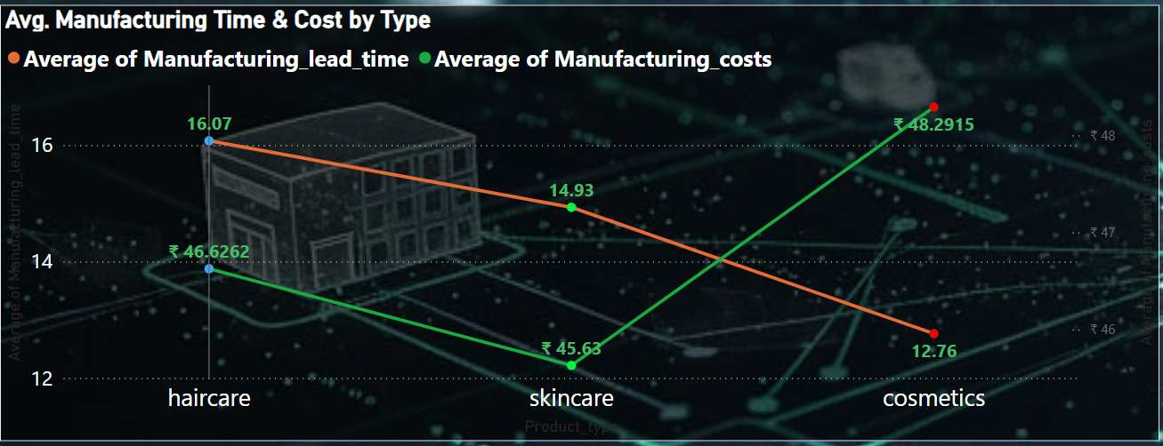
Avg. Manufacturing Time & Cost by Type
Insights :
Cosmetics are the costliest and fastest: This category has the highest average cost (₹48.29) but the lowest average lead time (12.76).
Haircare is the slowest: This category has the longest average manufacturing lead time (16.07) and a moderate cost (₹46.63).
Skincare is the cheapest: This category boasts the lowest average manufacturing cost (₹45.63) but has a mid-range lead time (14.93).
Solutions :
Focus on Haircare Efficiency: Investigate the Haircare manufacturing process (16.07 lead time) to identify bottlenecks and reduce the time, potentially saving costs.
Leverage Skincare Cost: Maximize the production and sales volume of Skincare (cheapest cost at ₹45.63) to boost overall profitability.

Slide 18
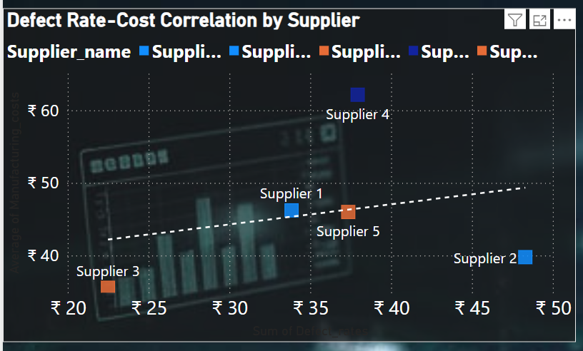
Defect Rate–Cost Correlation by Supplier
Insights :
Supplier 2 is the worst value: This supplier has the highest defect rate (around ₹47) but charges the lowest cost (around ₹40). The low cost does not compensate for the high defect risk.
Supplier 4 is the most expensive: This supplier has the highest manufacturing cost (over ₹60) and a high defect rate (around ₹38), offering poor value for money.
Solutions :
Reward and Prioritize Supplier 3: Immediately increase volume with Supplier 3 due to their low cost and highest quality (lowest defect rate).
Address Supplier 2: Reduce volume with Supplier 2, despite the low cost, until their high defect rate is drastically improved, as low price cannot offset high quality risk.
Review Supplier 4: Demand a cost reduction from Supplier 4, as their premium pricing (over ₹60) is not justified by their high defect rate. Shift volume elsewhere if costs aren't lowered.

Slide 19
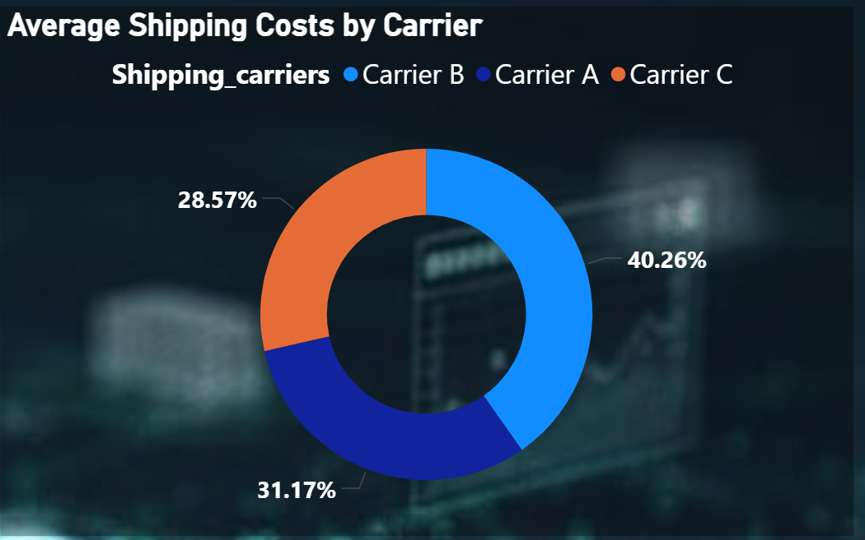
Average Shipping Costs by Carrier
Insights :
Carrier A has the highest average shipping cost share at 40.26%, making them the most expensive carrier overall.
Carrier B follows closely with a significant cost share of 31.17%.
Carrier C has the lowest average shipping cost share at 28.57%, making them the most cost-effective option.
Solutions :
Shift Volume to Carrier C: Prioritize increasing shipping volume with Carrier C (28.57%) to immediately lower the overall average shipping expense.
Negotiate with Carrier A: Engage in urgent negotiations with Carrier A (40.26%) to reduce their high rates, using the lower costs of Carriers B and C as leverage.
Diversify Shipments: Aim to shift volume from Carrier A and B toward Carrier C until the cost shares are more balanced, or until Carrier C handles the majority of shipments to maximize savings.

Slide 20
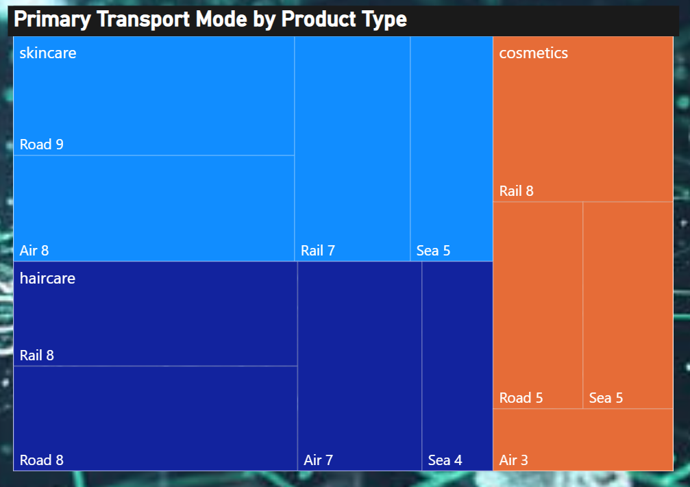
Primary Transport Mode by Product Type
Insights :
Skincare Dominates Transport: Skincare takes up the largest overall transport volume, with Road (9) being its most used mode, suggesting local or domestic focus.
Road is Key Overall: Road transport is the most frequently used mode across the combined categories (Skincare 9, Haircare 8, Cosmetics 5), indicating a heavy reliance on trucking.
Sea is Least Used: Sea transport has the lowest total usage (Skincare 5, Haircare 4, Cosmetics 5), suggesting limited reliance on intercontinental or large-volume container shipping.
Solutions :
Optimize Road Logistics: Since Road is the highest volume mode, focus on negotiating better rates and improving load efficiency for all road shipments.
Review Sea Transport: Investigate why Sea transport is low; if costs are the barrier, negotiate cheaper contracts for large-volume, non-urgent shipments to lower overall freight costs.

Slide 21
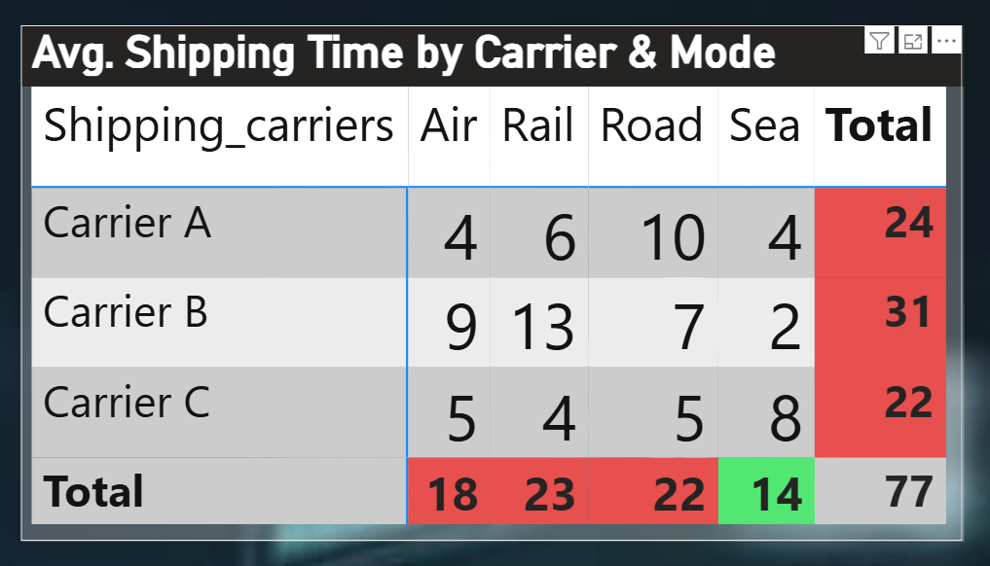
Avg. Shipping Time by Carrier & Mode
Insights :
Carrier C is the fastest overall with a total average shipping time of 22.
Carrier B is the slowest overall with a total average shipping time of 31.
Sea is the fastest overall mode with a total time of 14, while Rail is the slowest at 23.
Road transport shows the largest variation: Carrier A is very slow (10), but Carrier C is fast (5).
Solutions :Maximize Carrier C Usage: Shift as much volume as possible to Carrier C to benefit from the lowest average shipping time of 22.
Avoid Carrier B/Rail: Reduce reliance on Carrier B and the Rail mode where possible, as they contribute the most to overall shipping delays.
Focus on Carrier A's Road Time: Investigate why Carrier A's Road time is so high (10), as fixing this one factor could significantly improve their overall performance (currently 24).

Slide 22
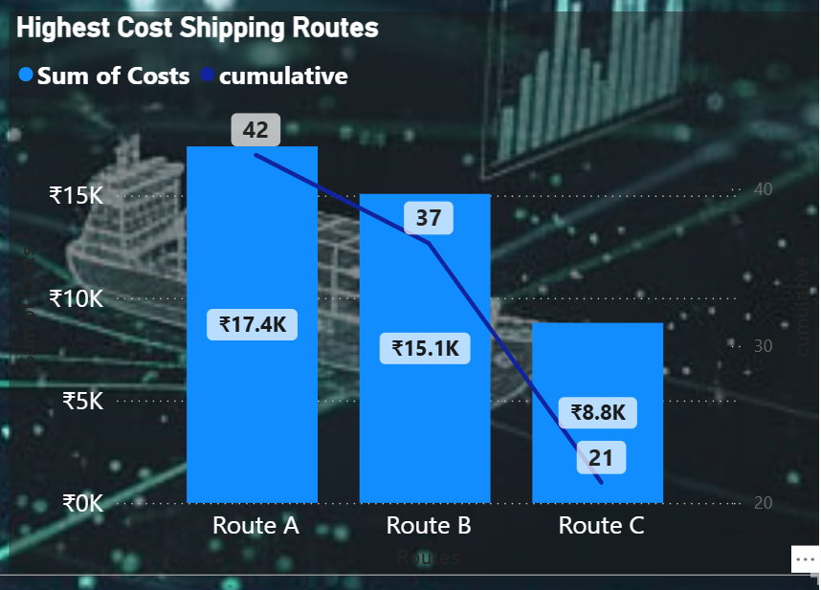
Highest Cost Shipping Routes
Insights :
Route A is the costliest route by a significant margin, totaling ₹17.4K, which is 42% of the cumulative cost shown.
Routes A and B combined account for 79% (42% + 37%) of the total cumulative shipping cost, following the Pareto principle (the 80/20 rule).
Route C is the least expensive of the top three routes, contributing only ₹8.8K (21% of the cumulative total). Solutions :
Prioritize Optimization of Route A: Focus cost-reduction efforts exclusively on Route A first, as it offers the highest potential savings due to its dominant cost (₹17.4K).
Source Alternatives for Route A and B: Actively seek alternative carriers or transport modes for Routes A and B to break the costly reliance on the current setup.
Leverage Route C's Success: Analyze the efficiency of Route C (₹8.8K) and try to apply any cost-saving processes or negotiated rates to the operation of Routes A and B.

Slide 23
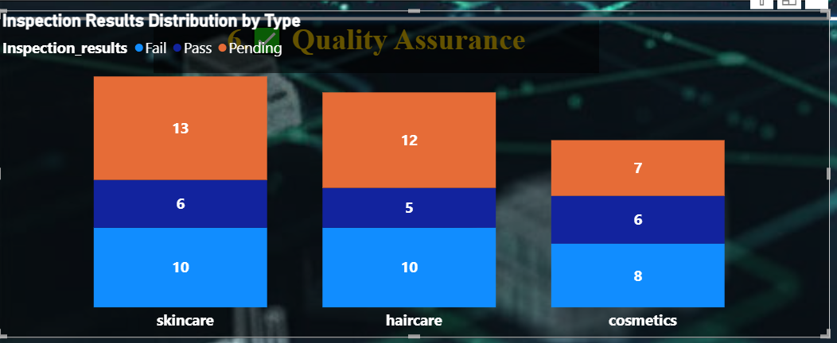
Inspection Results Distribution by Type
Insights :
Skincare has the highest failure count with 13 failed inspections, making it the category with the most significant quality issues.
Haircare has the highest volume of passed inspections with 10, though its overall failure and pending count (12 and 5 respectively) remain high.
Cosmetics has the lowest total volume and the lowest failure count (7), suggesting it is the most stable category in terms of quality and inspection volume.
Solutions :
Prioritize Quality Improvement for Skincare: Immediately focus quality assurance resources on Skincare to identify the root cause of the 13 failures and reduce the high 13 pending items.
Streamline Pending Process: Develop a faster process to clear the high number of Pending inspections in Skincare (13) and Haircare (12) to get products to market faster.

Slide 24
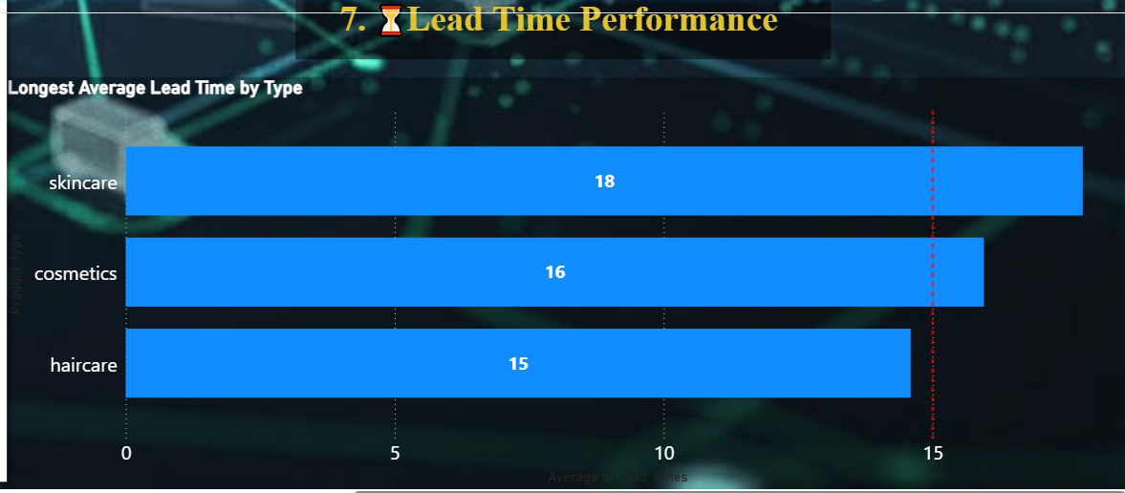
Longest Average Lead Time by Type
Insights :
Skincare has the longest average lead time at 18 (likely days or weeks), making it the slowest category to replenish or get to market.
Haircare has the shortest average lead time at 15, making it the quickest category to process.
Both Skincare (18) and Cosmetics (16) exceed the visible target or benchmark line, which is set at 15.
Solutions :
Target Skincare for Improvement: Immediately focus process review efforts on Skincare (18) to identify bottlenecks and reduce its lead time below the 15-point target.
Streamline Cosmetics: Implement minor adjustments to the Cosmetics process (16) to quickly shave off 1 point and meet the 15-point target.
Maintain Haircare Efficiency: Ensure the efficient process for Haircare (15) is documented and maintained, and explore applying its successful practices to the other two categories

Slide 25
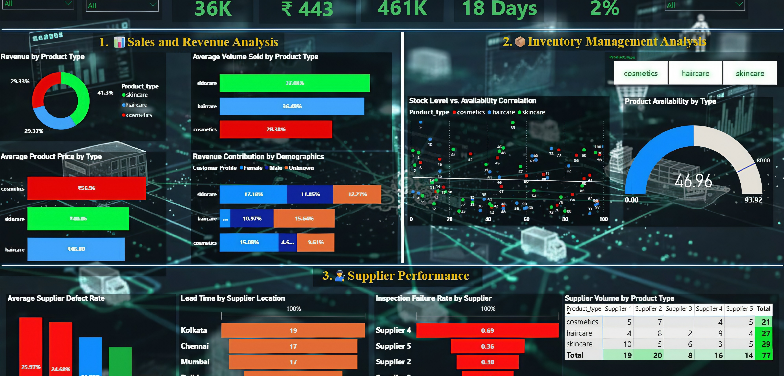
Final Dashboard

Slide 26
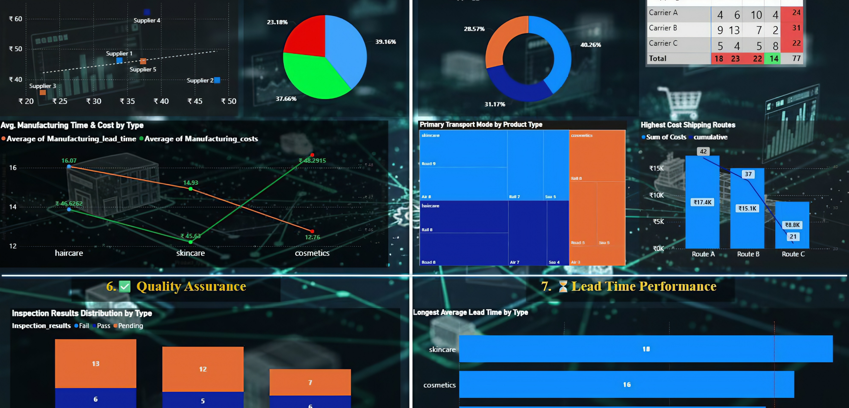
Final Dashboard

Slide 27
Final dashboard overview: supply chain analysis
This dashboard provides a complete visual summary of the Supply Chain Performance across all stages — from Sales to Quality Assurance.
Key Insights Covered:
Sales and revenue trends by product type
Inventory levels and availability status
Supplier performance and defect rates
Production timelines and cost efficiency
Shipping time, mode, and cost analysis
Overall lead time and quality metrics
Purpose: To help management monitor real-time supply chain metrics, identify performance gaps, and optimize operations across departments.

Slide 28
Thank You

